Slide 1
PHOTODETECTORS
S7-S9

Slide 2
PHOTODETECTORS
PHOTODETECTORS: Photodetectors find applications in the area of medical, automotive, safety and analytical equipments, cameras, communications, astronomy and industry.
Types of Photo detectors
Photodiode, Photodiode Array, Light Dependent Resistor
Avalanche Photodiode
Photomultiplier Tube, Micro channel Plate, Image Intensifier
Position Sensitive Detector
CCD

Slide 3
Photo detector Requirements for Performance
High sensitivity at the operating wavelength of the source
Short response time to obtain a desirable bandwidth
Minimum noise contribution
Compatible size for efficient coupling and packaging
Linear response over a wide range of light intensity
Stability of performance characteristics ➢ Low bias voltage
Low cost

Slide 4
Photo detection Mechanisms
Photodetector converts light (power) into electrical signals (photocurrent).
There are two distinct photo detection mechanisms
1. External photoelectric effect :
Photomultiplier Tubes (PMT)
2. Internal photoelectric effect :
PN junction photodiodes
PIN photodiodes
Avalanche photodiodes

Slide 5
Photo detection Mechanisms
External photoelectric effect
Electrons become free from the metal surface by energy absorption obtained by streams of incident photons.
2. Internal photoelectric effect
Free charge carriers are generated by absorption of incident photons in semiconductor junction detectors.

Slide 6
Principle of Photodetection (In Semiconductor)
In semiconductors, conduction band and valence band are separated by a forbidden band gap.
Electrons at the valance band are bound. The electrons in the conduction band are free and when small voltage is applied they move and causes current flow
Populating the conduction band with electrons causes the semiconductor to conduct current.
The value of band gap Eg determines the conductive properties of semiconductor

Slide 7
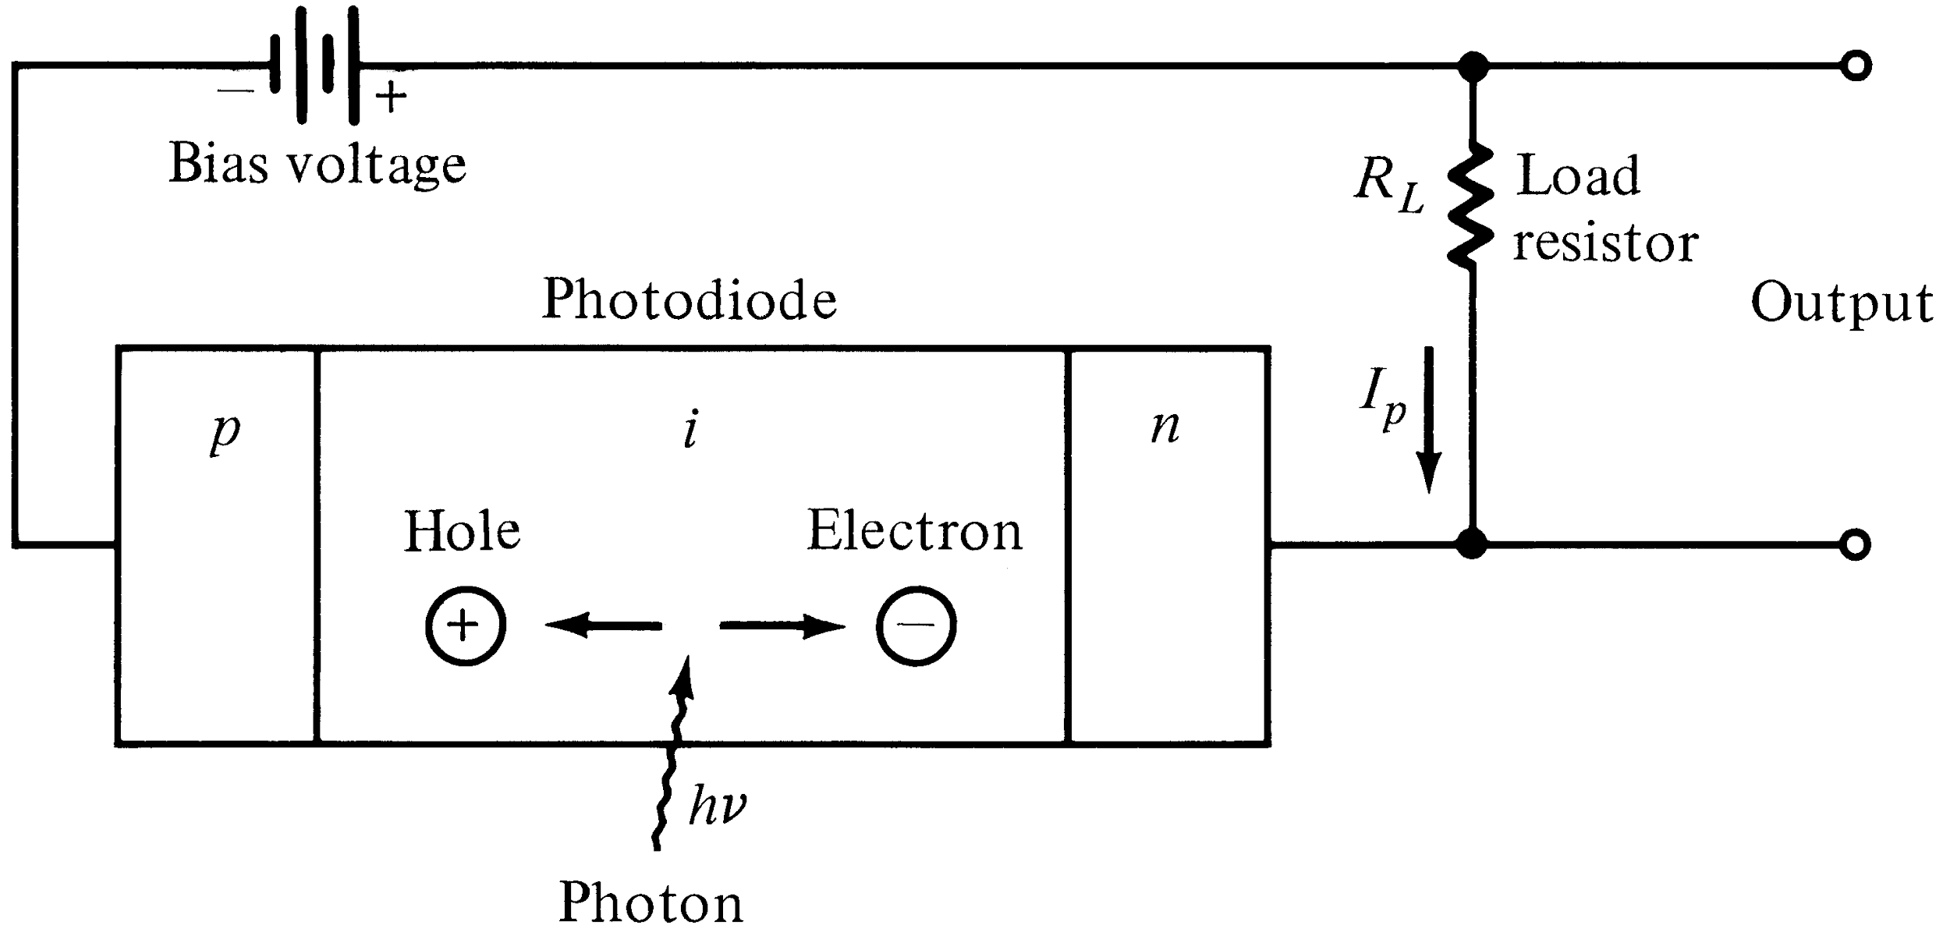
PIN PHOTODIODE
The high electric field present in the depletion region causes photo-generated carriers to
Separate and be collected across the reverse –biased junction. This give rise to a current
Flow in an external circuit, known as photocurrent.

Slide 8
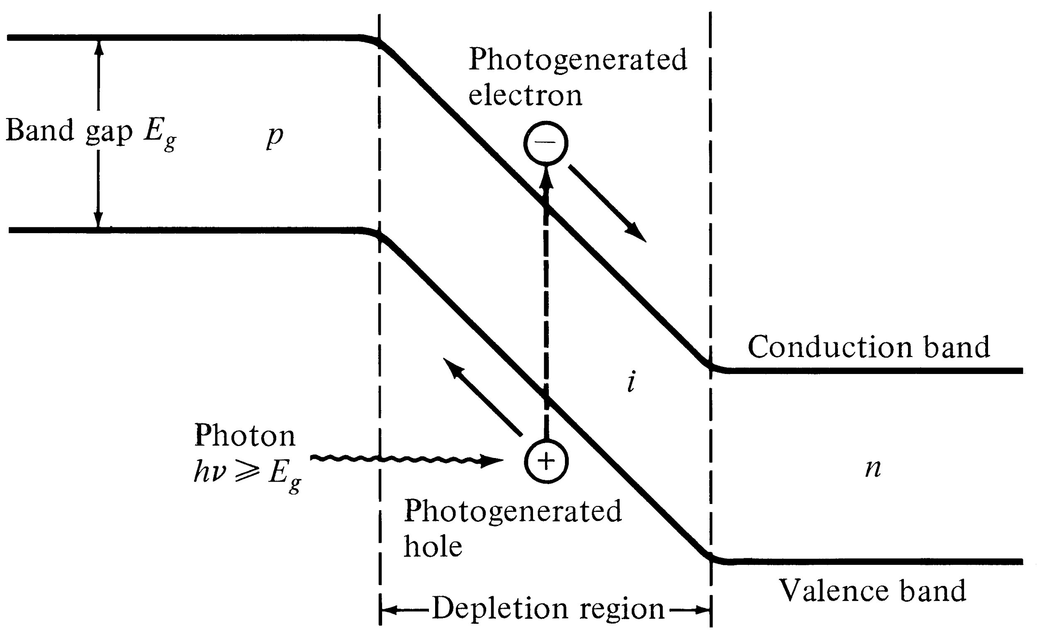
Energy-Band diagram for a pin photodiode

Slide 9
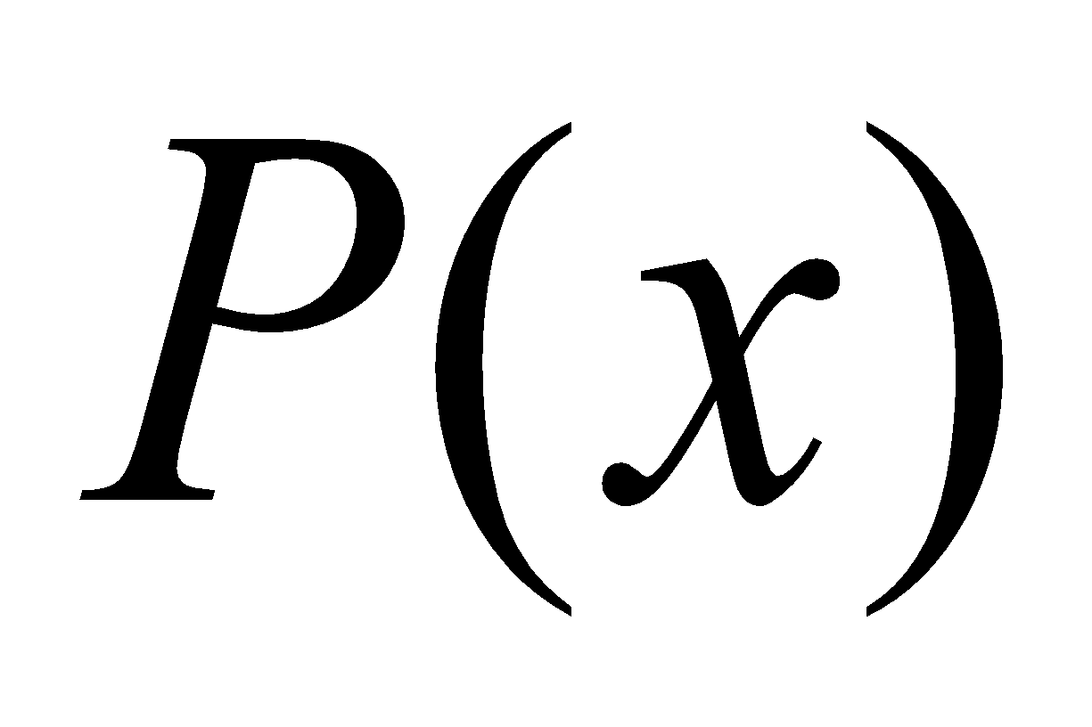
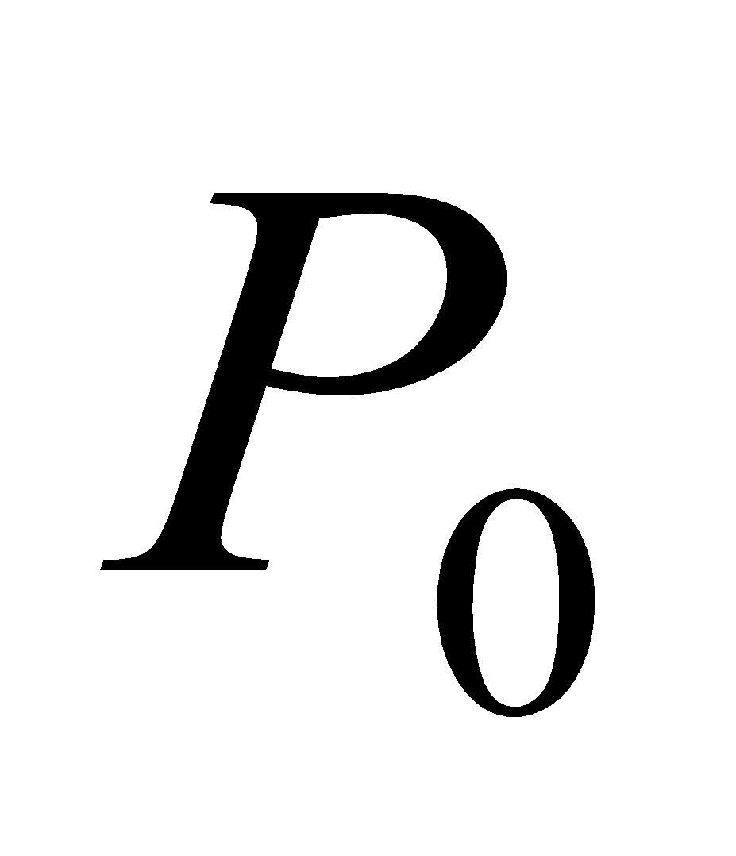
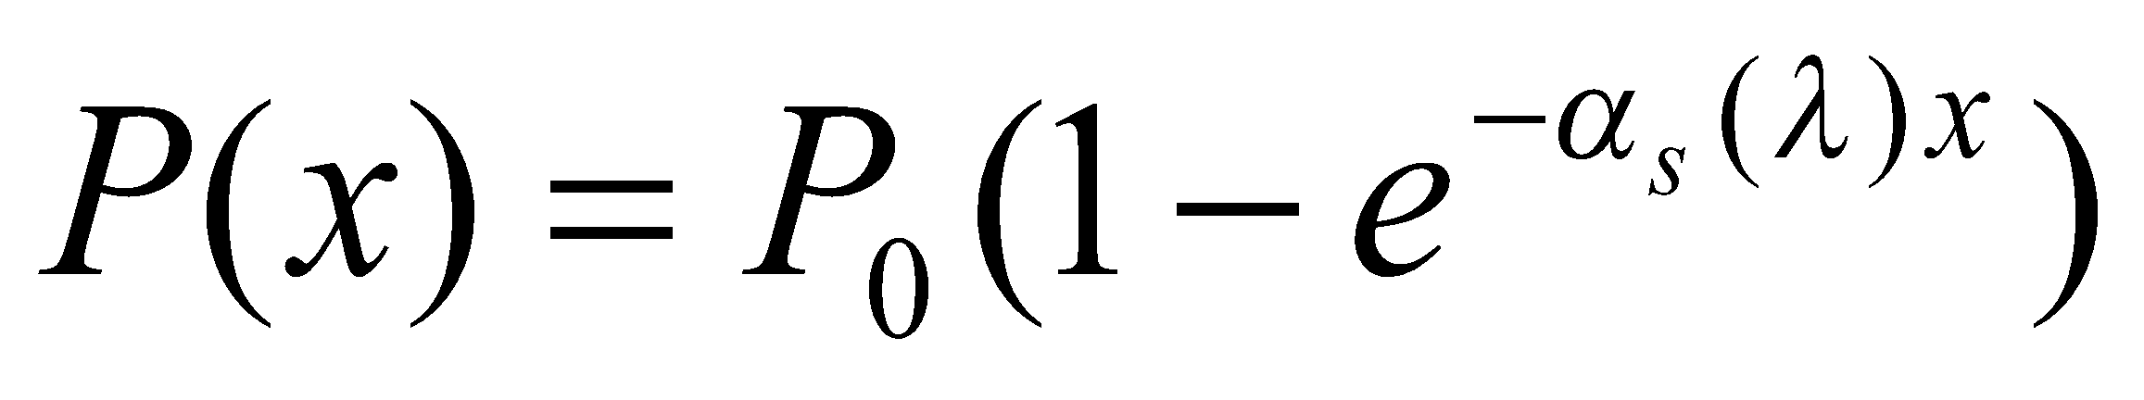
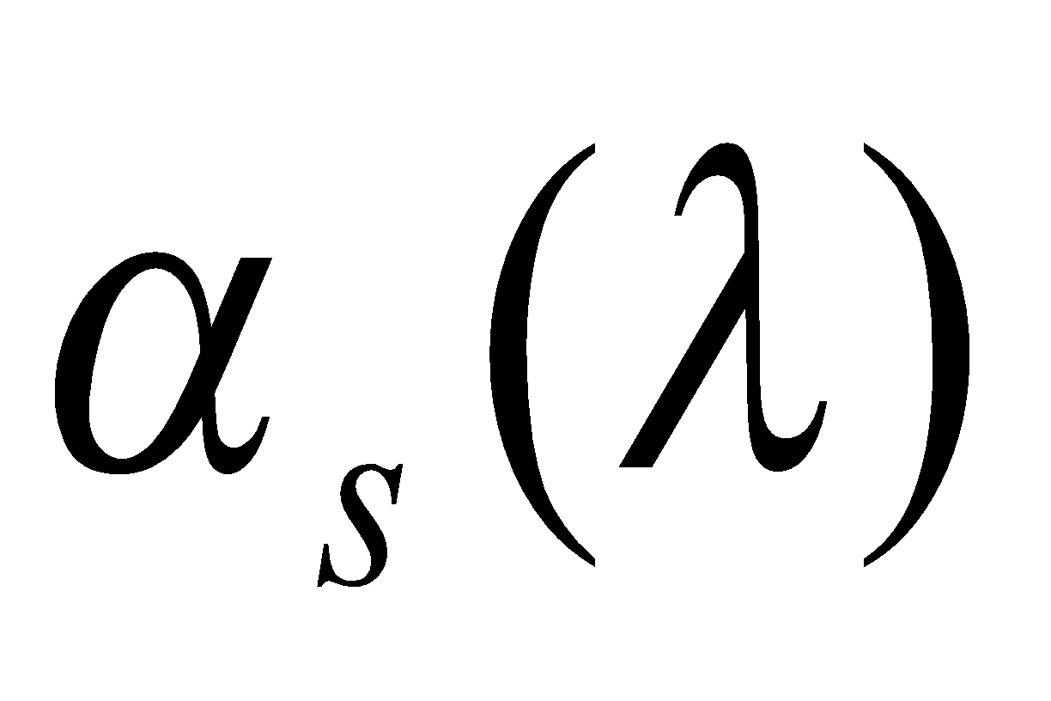
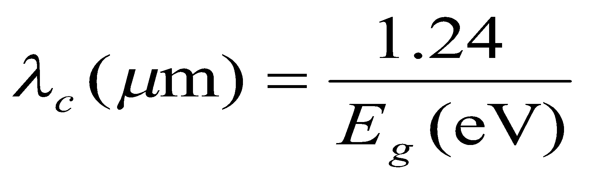
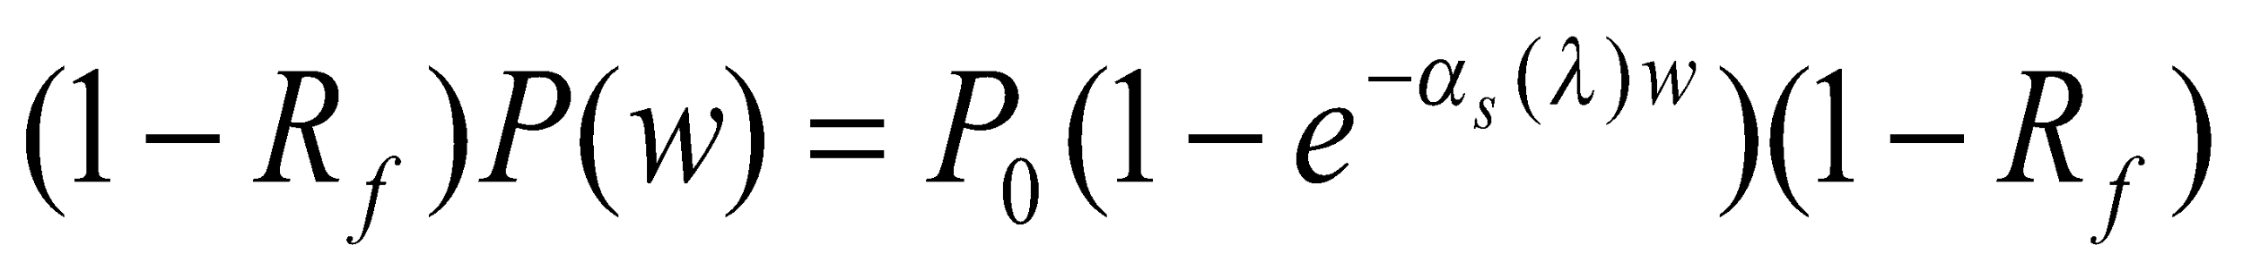
Photocurrent
Optical power absorbed, in the depletion region can be written in terms of incident optical power, :
Absorption coefficient strongly depends on wavelength. The upper wavelength cutoff for any semiconductor can be determined by its energy gap as follows:
Taking entrance face reflectivity into consideration, the absorbed power in the width of depletion region, w, becomes:
[6-1]
[6-2]

Slide 10
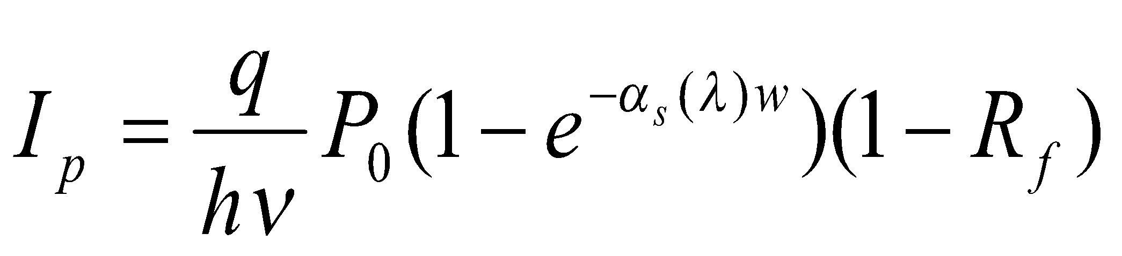
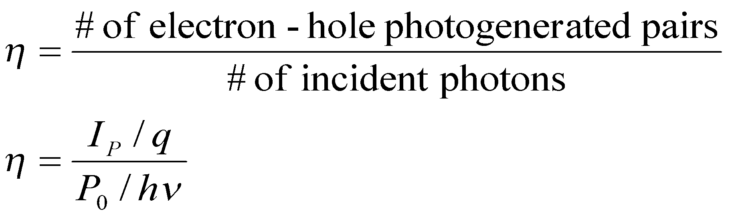
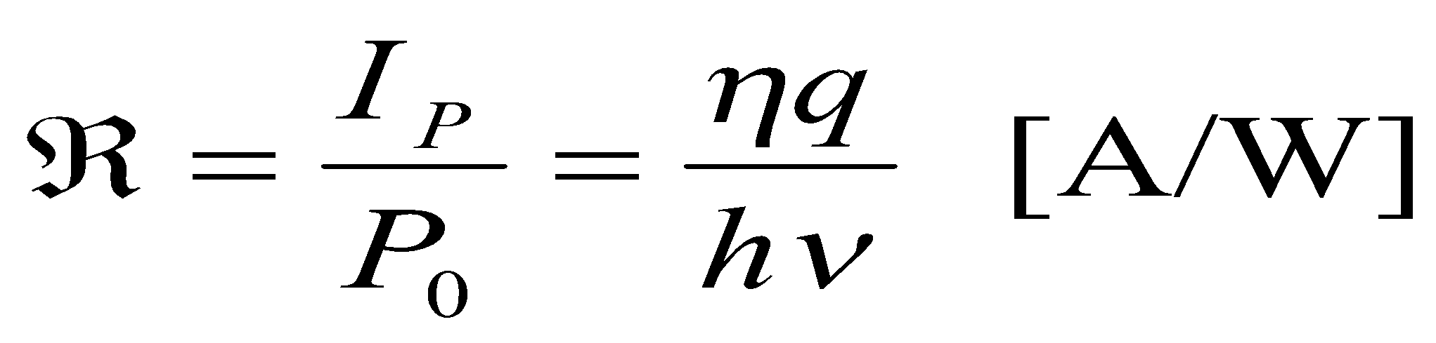
Responsivity
The primary photocurrent resulting from absorption is:
Quantum Efficiency:
Responsivity:
[6-3]
[6-4]
[6-5]

Slide 11
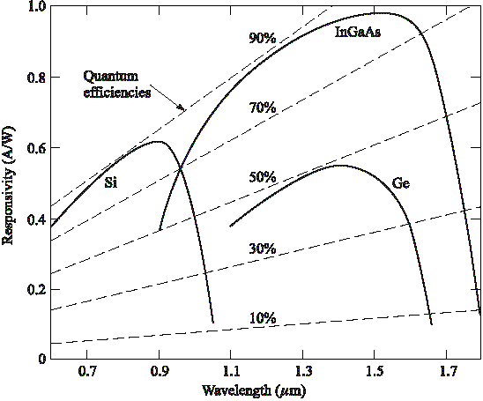
Responsivity vs. wavelength

Slide 12
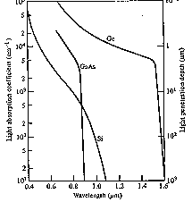
Optical Absorption Coefficient

Slide 13
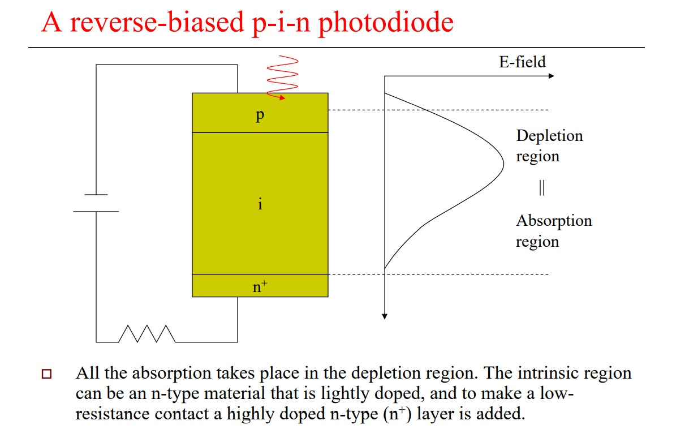

Slide 14
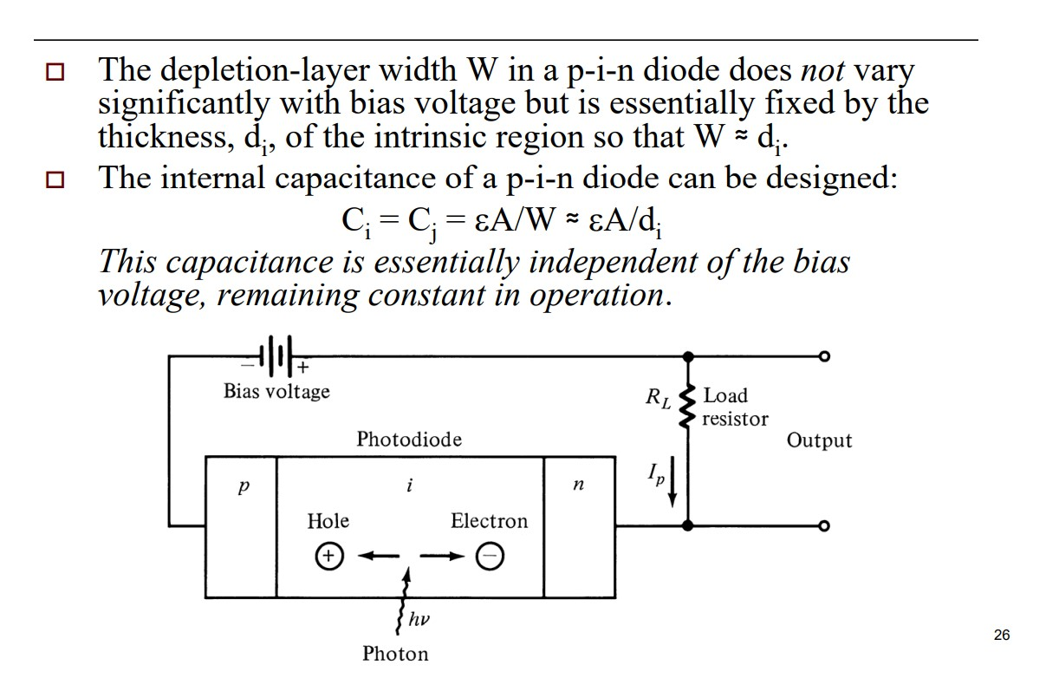

Slide 15
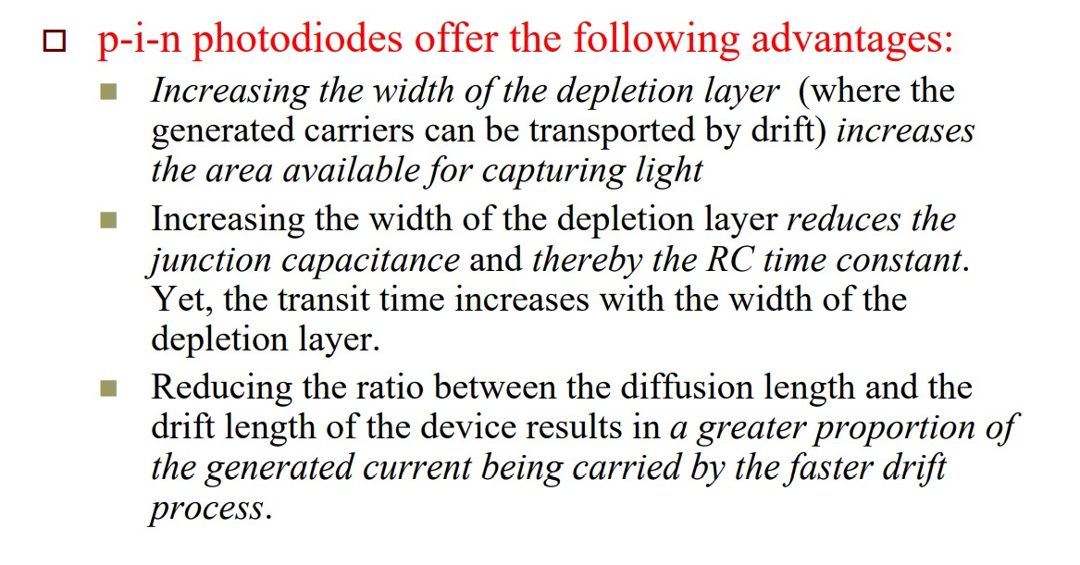

Slide 16
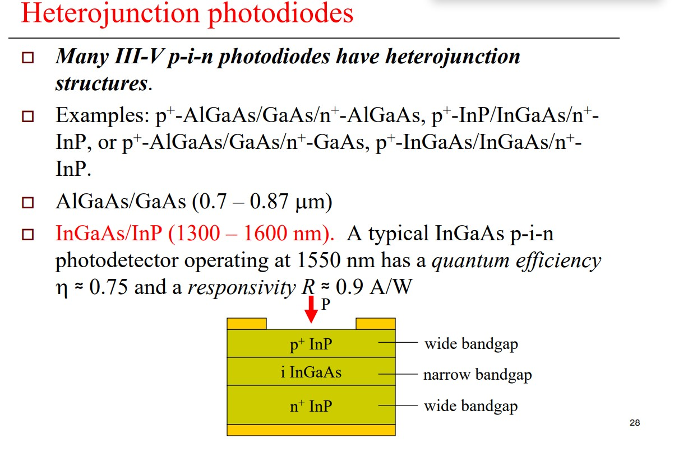

Slide 17
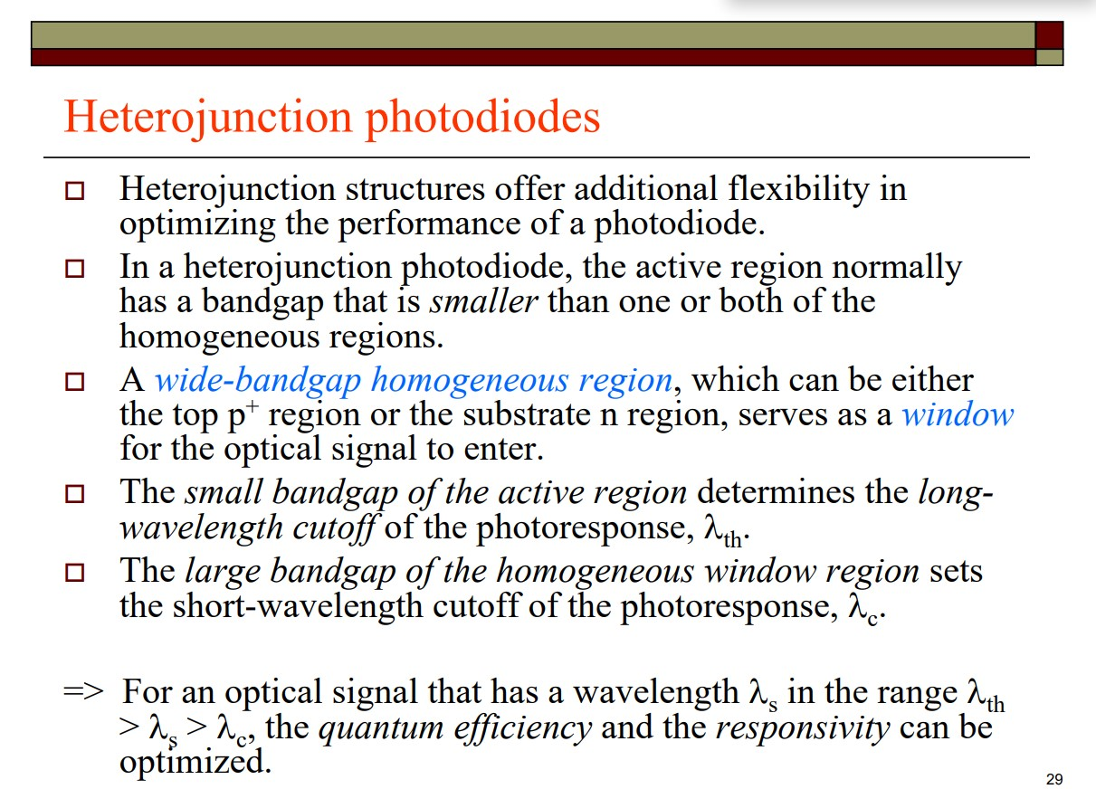

Slide 18
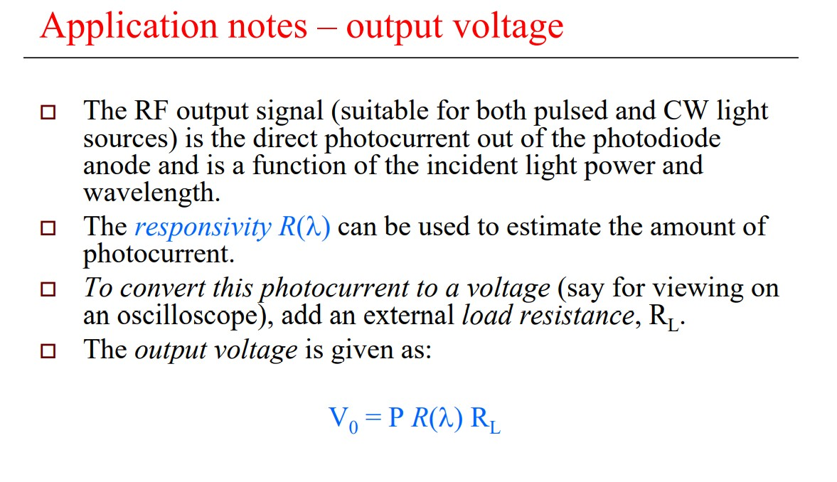

Slide 19
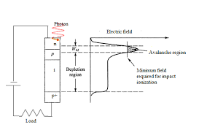
Avalanche Photodiode (APD)
APDs internally multiply the primary photocurrent before it enters to following circuitry.
In order to carrier multiplication take place, the photogenerated carriers must traverse along a high field region. In this region, photogenerated electrons and holes gain enough energy to ionize bound electrons in VB upon colliding with them. This multiplication is known as impact ionization. The newly created carriers in the presence of high electric field result in more ionization called avalanche effect.
Reach-Through APD structure (RAPD)
showing the electric fields in depletion region and multiplication region.

Slide 20
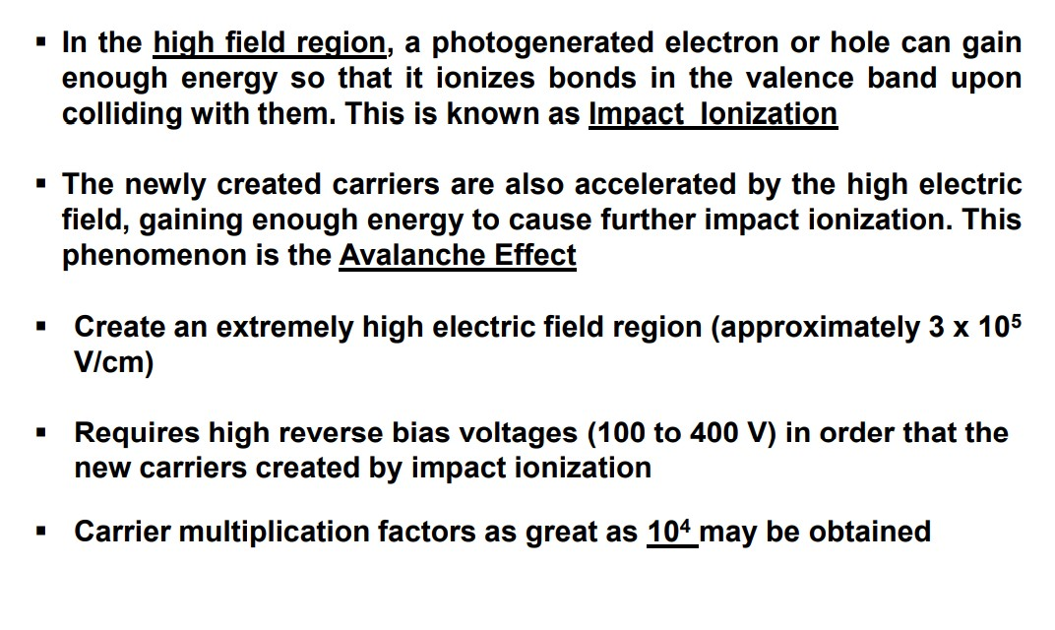

Slide 21
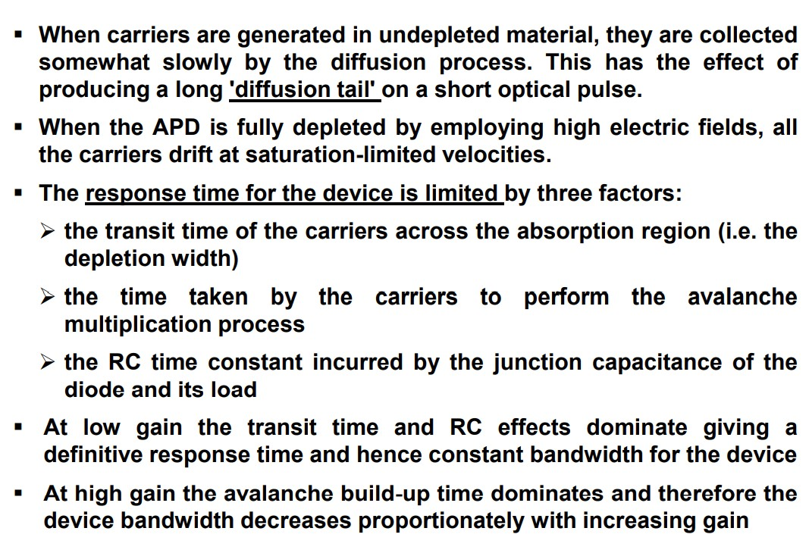

Slide 22
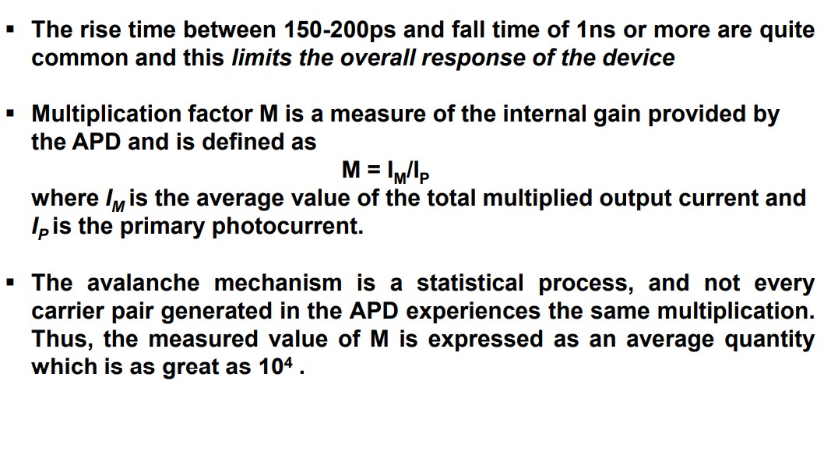
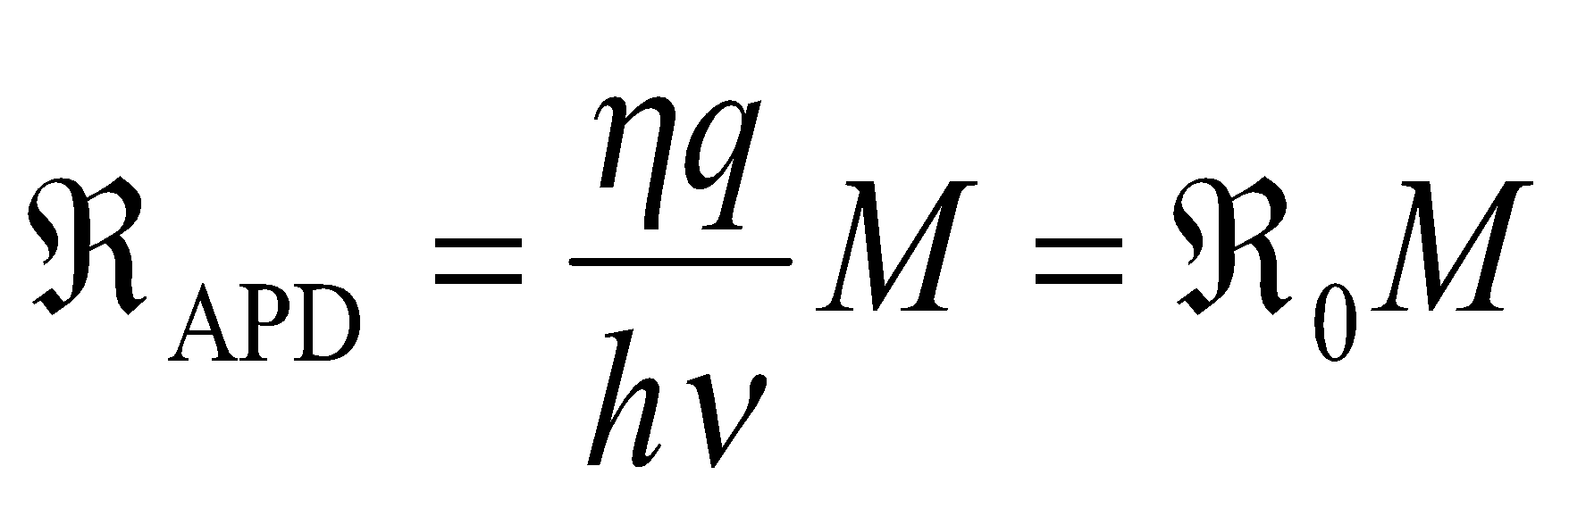
The responsivity of APD can be calculated by considering the current gain as:

Slide 23
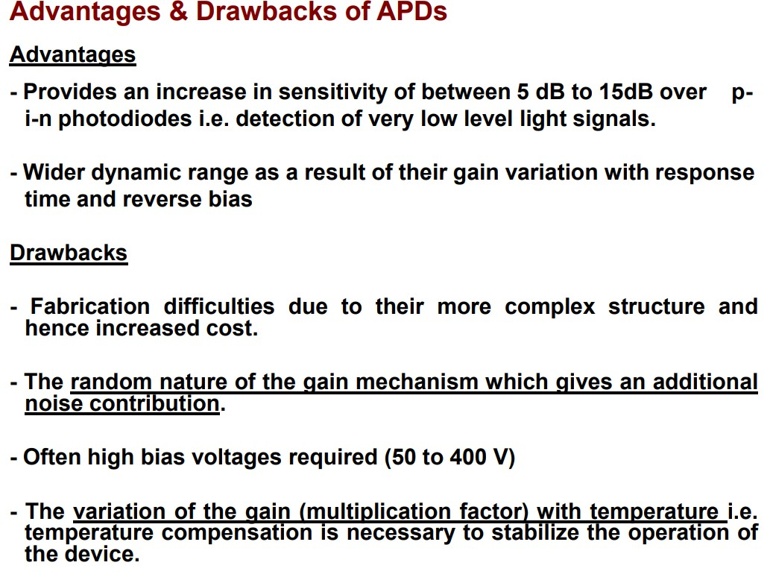

Slide 24
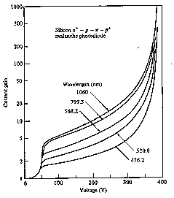
Current gain (M) vs. Voltage for different optical wavelengths

Slide 25
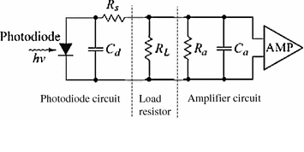
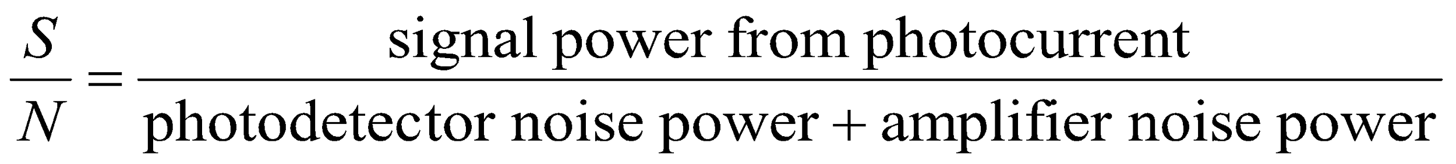
Photodetector Noise & S/N
Detection of weak optical signal requires that the photodetector and its following amplification circuitry be optimized for a desired signal-to-noise ratio.
It is the noise current which determines the minimum optical power level that can be detected. This minimum detectable optical power defines the sensitivity of photodetector. That is the optical power that generates a photocurrent with the amplitude equal to that of the total noise current (S/N=1)
Equivalent circuit of photodetector

Slide 26
Noise Sources in Photodetecors
The principal noises associated with photodetectors are :
1- Quantum (Shot) noise: arises from statistical nature of the production and collection of photo-generated electrons upon optical illumination. It has been shown that the statistics follow a Poisson process.
2- Dark current noise: is the current that continues to flow through the bias circuit in the absence of the light. This is the combination of bulk dark current, which is due to thermally generated e and h in the pn junction, and the surface dark current, due to surface defects, bias voltage and surface area.
In order to calculate the total noise presented in photodetector, we should sum up the root mean square of each noise current by assuming that those are uncorrelated.
Total photodetector noise current=quantum noise current +bulk dark current noise + surface current noise

Slide 27
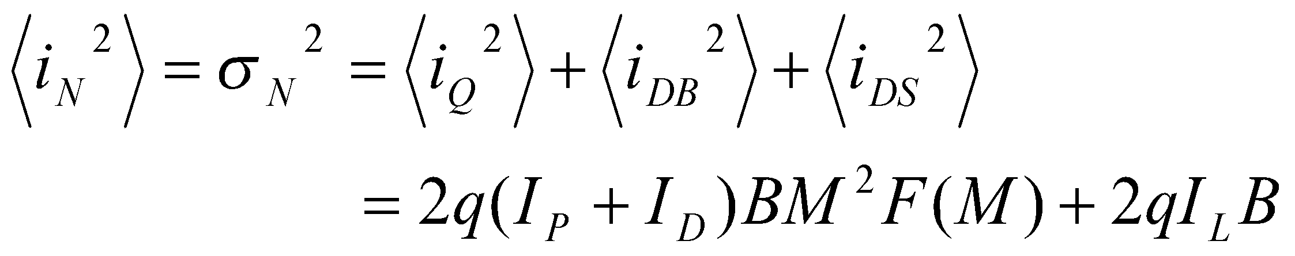
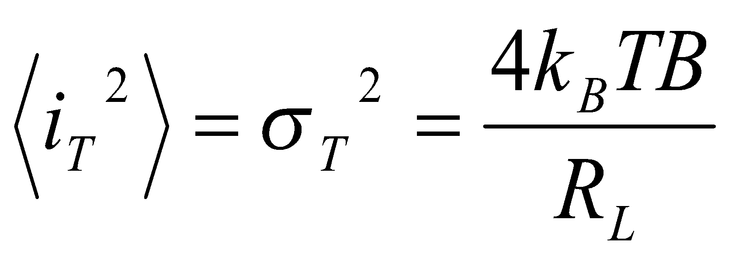

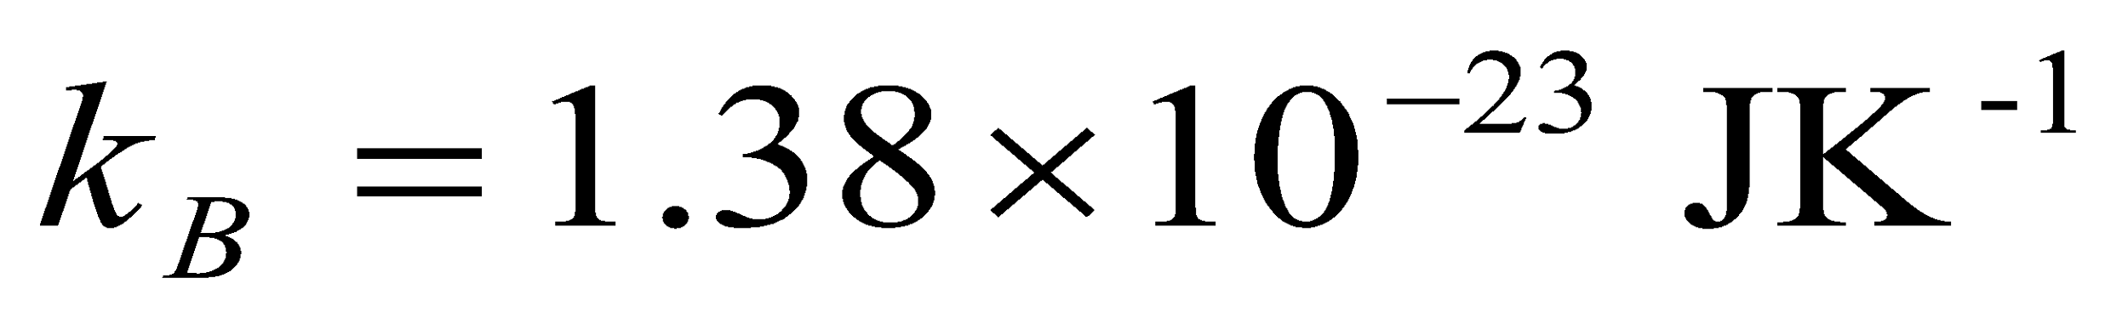
Noise calculation (2)
The total rms photodetector noise current is:
The thermal noise of amplifier connected to the photodetector is:
input resistance of amplifier, and is Boltzmann cte.
[6-14]
[6-15]

Slide 28
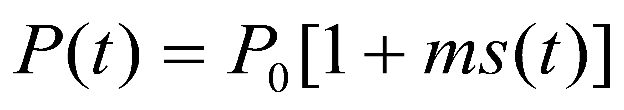
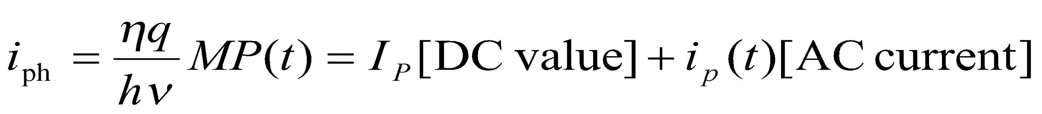
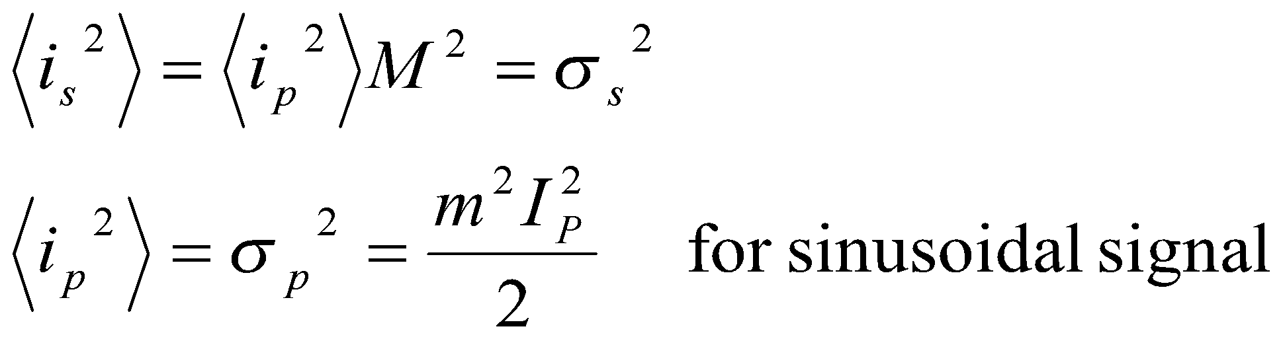
Signal Calculation
Consider the modulated optical power signal P(t) falls on the photodetector with the form of:
Where s(t) is message electrical signal and m is modulation index. Therefore the primary photocurrent is (for pin photodiode M=1):
The root mean square signal current is then:
[6-8]
[6-9]
[6-9]
[6-10]

Slide 29
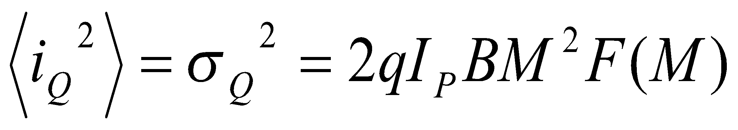
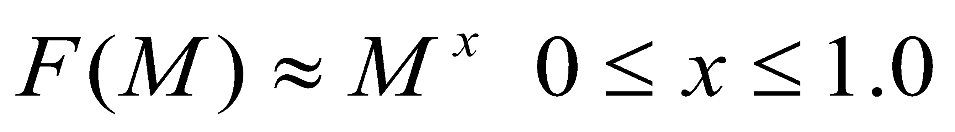
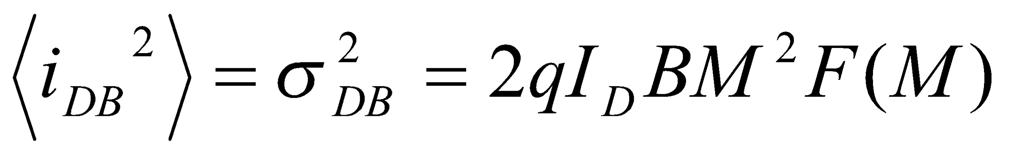

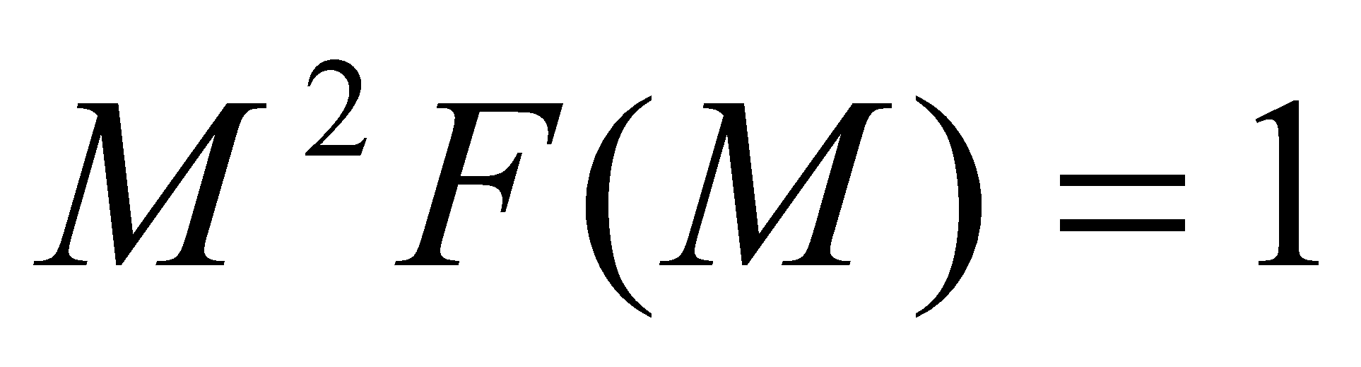
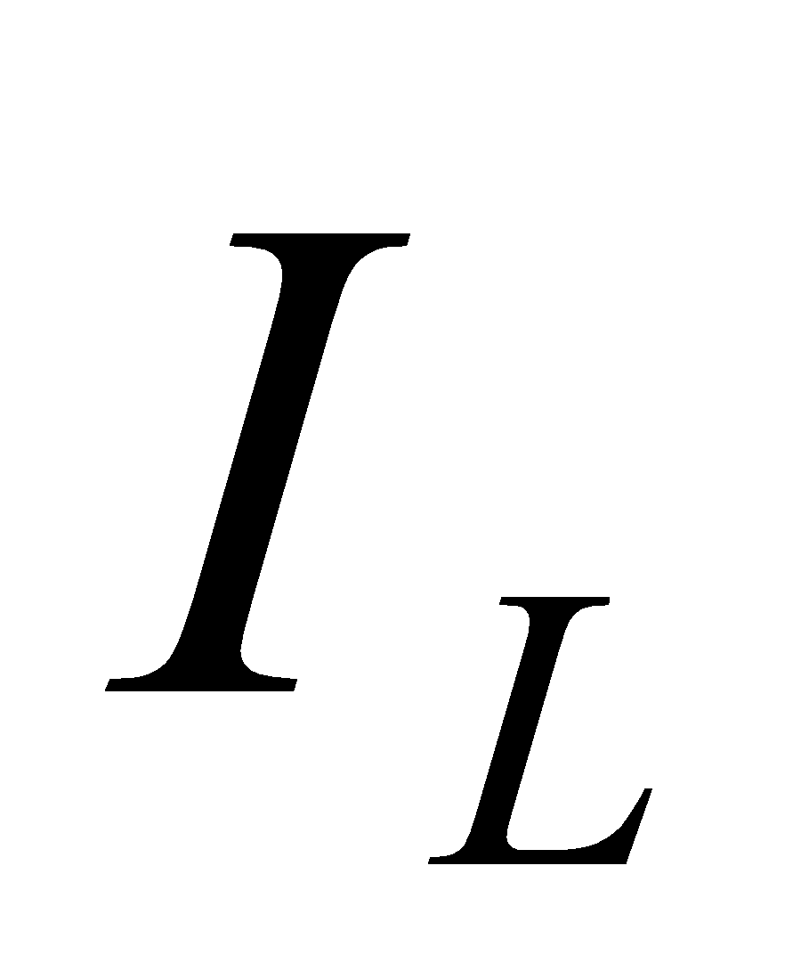
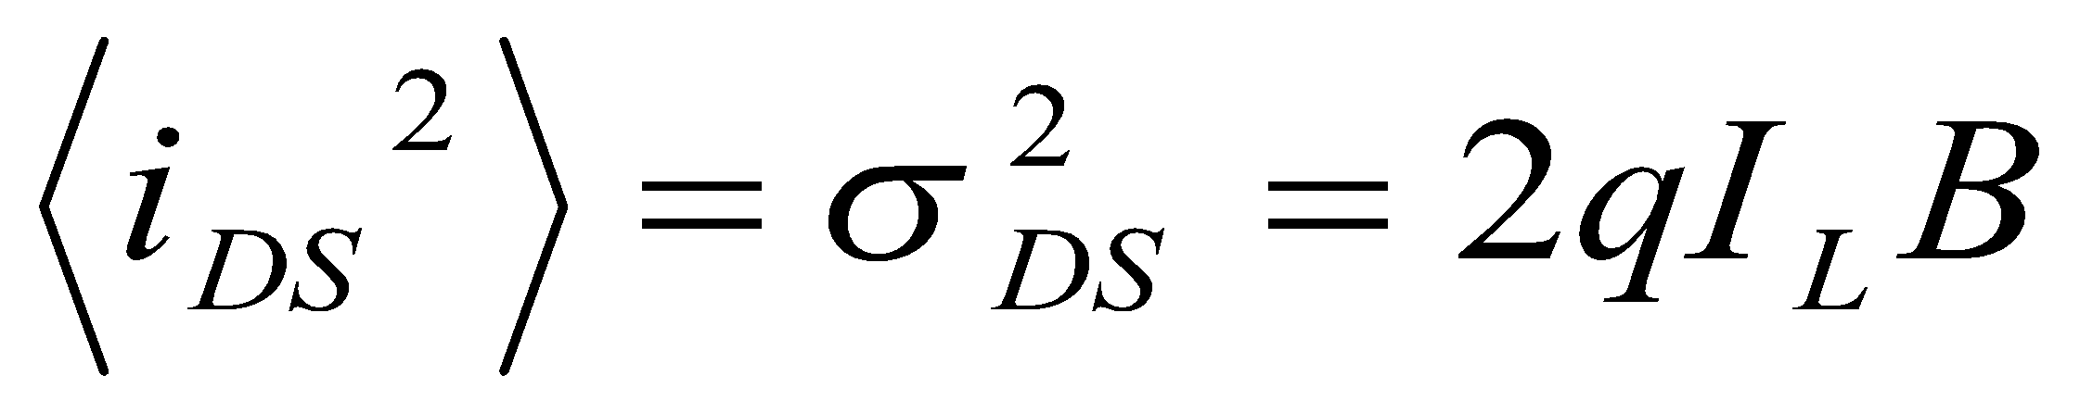
Noise calculation (1)
Quantum noise current (lower limit on the sensitivity):
B: Bandwidth, F(M) is the noise figure and generally is
Bulk dark current noise:
is bulk dark current
Surface dark current noise: is the surface current.
[6-11]
[6-12]
Note that for pin photodiode
[6-13]

Slide 30
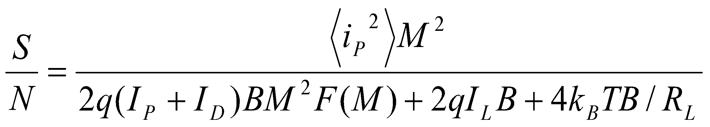
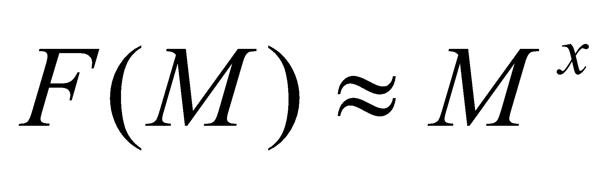
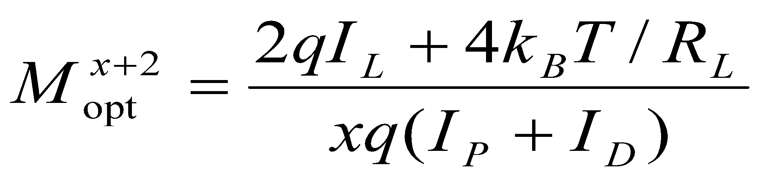
S/N Calculation
Having obtained the signal and total noise, the signal-to-noise-ratio can be written as:
Since the noise figure F(M) increases with M, there always exists an optimum value of M that maximizes the S/N. For sinusoidally modulated signal with m=1 and :
[6-16]
[6-17]

